Slide 1

CSCE883 Machine Learning
Lecture 5 Linear Discriminant, Logistic Regression, Decision Tree, Random Forest
Jianjun Hu
Department of Computer Science & Engineering
University of South Carolina

Slide 2
Likelihood- vs. Discriminant-based Classification
Likelihood-based: Assume a model for p(x|C_{i}), use Bayes’ rule to calculate P(C_{i}|x)
g_{i}(x) = log P(C_{i}|x)
Discriminant-based: Assume a model for g_{i}(x|Φ_{i}); no density estimation
Estimating the boundaries is enough; no need to accurately estimate the densities inside the boundaries

Slide 3
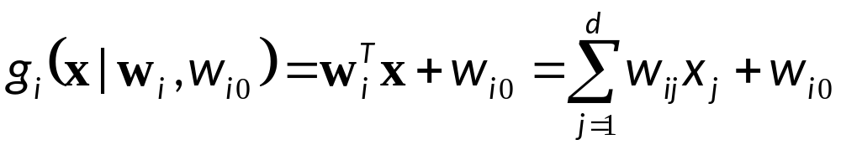
Linear Discriminant
Linear discriminant:
Advantages:
  Simple: O(d) space/computation
  Knowledge extraction: Weighted sum of attributes; positive/negative weights, magnitudes (credit scoring)
  Optimal when p(x|C_{i}) are Gaussian with shared cov matrix; useful when classes are (almost) linearly separable

Slide 4

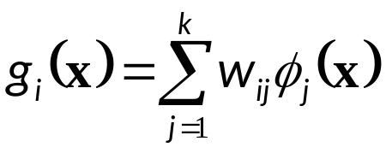
Generalized Linear Model
Quadratic discriminant:
Higher-order (product) terms:
Map from x to z using nonlinear basis functions and use a linear discriminant in z-space

Slide 5
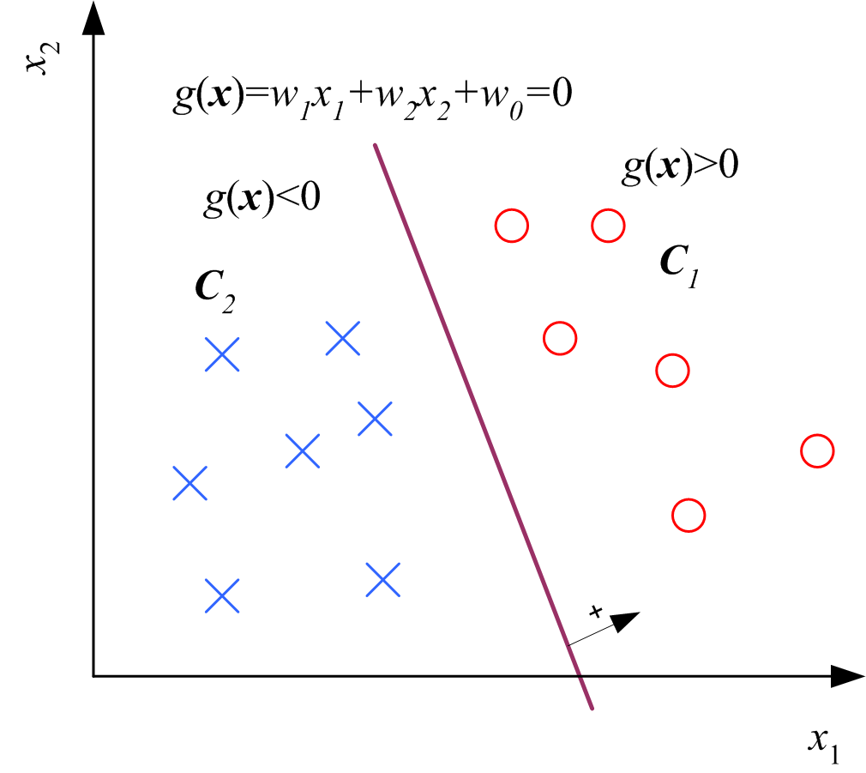
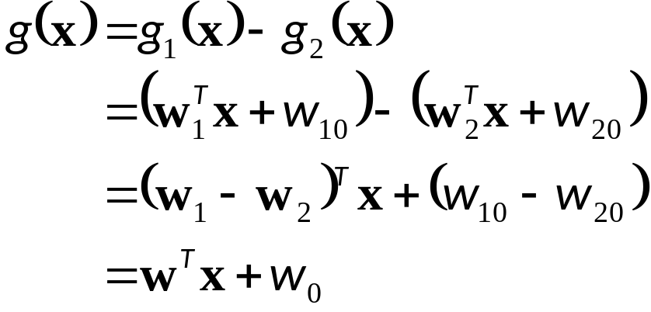
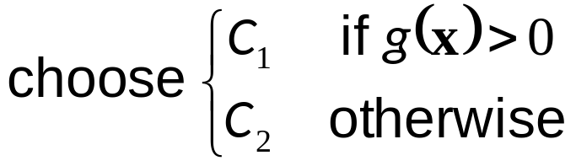
Two Classes

Slide 6
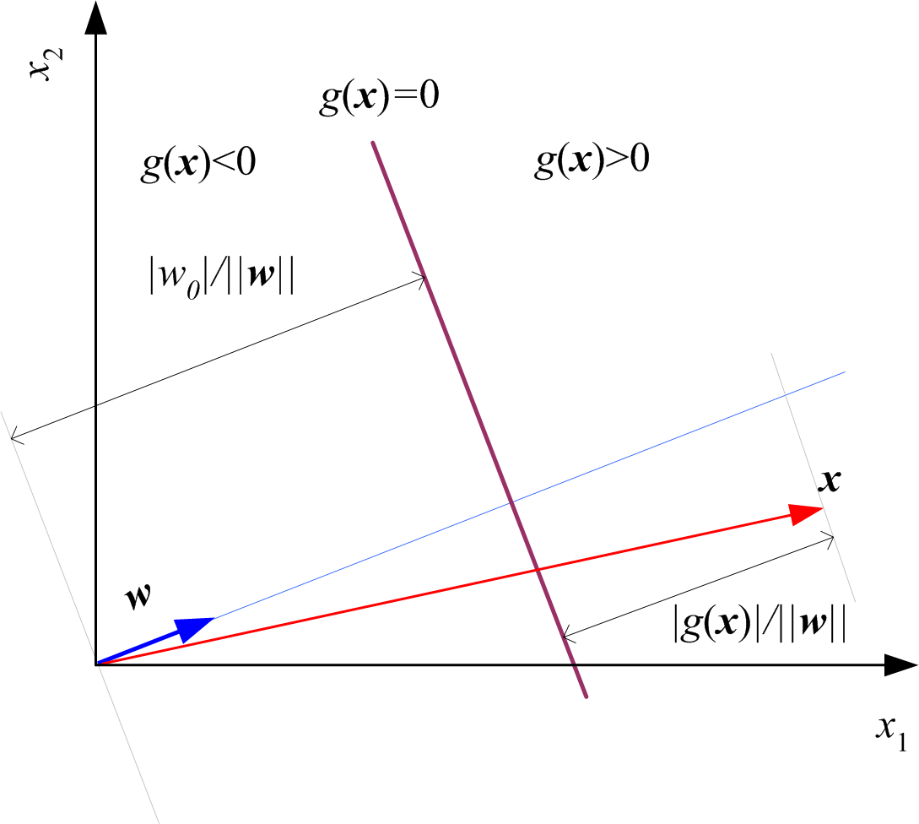
Geometry

Slide 7
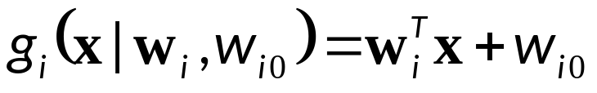
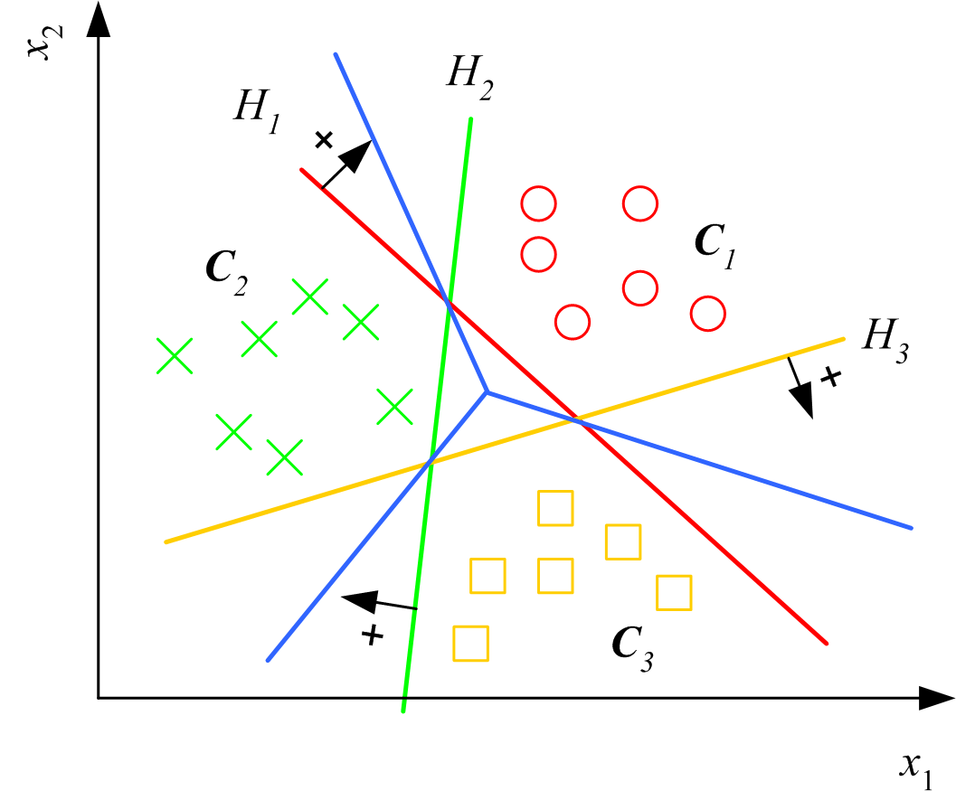
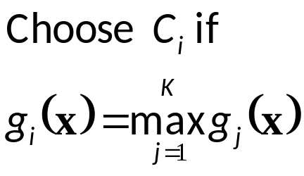
Multiple Classes
Classes are
linearly separable

Slide 8
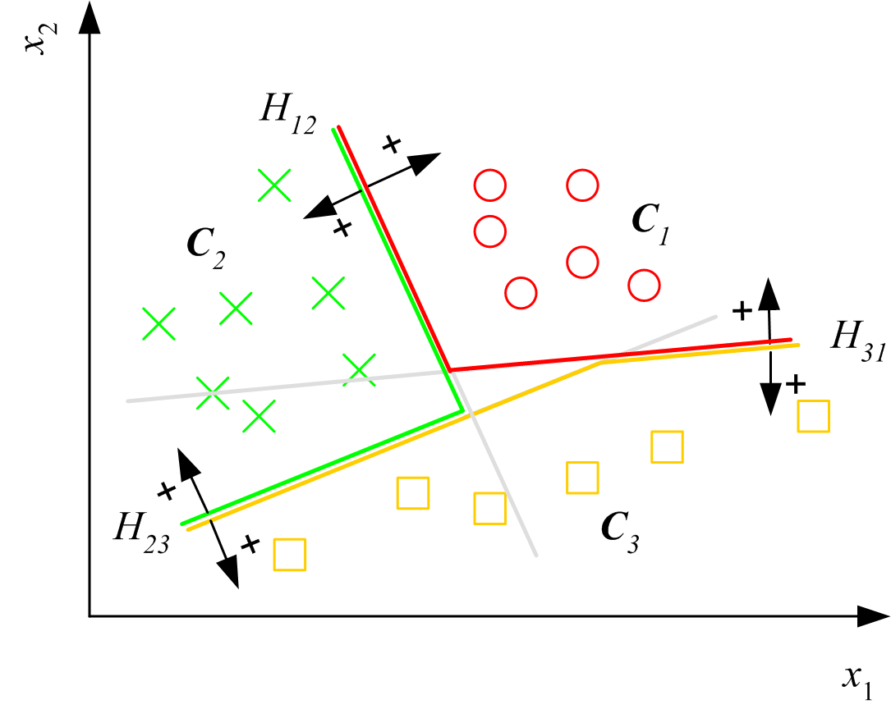
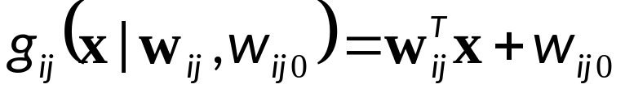
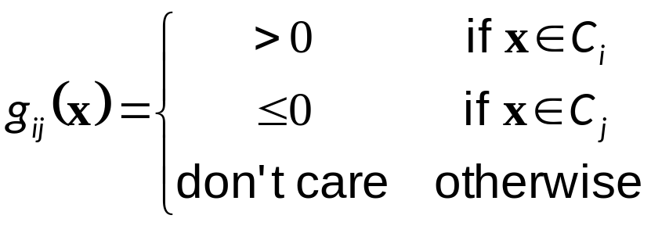
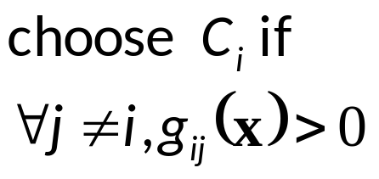
Pairwise Separation

Slide 9
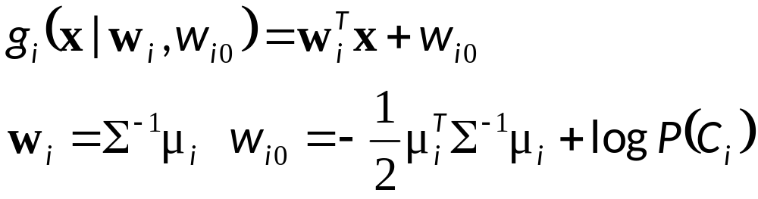
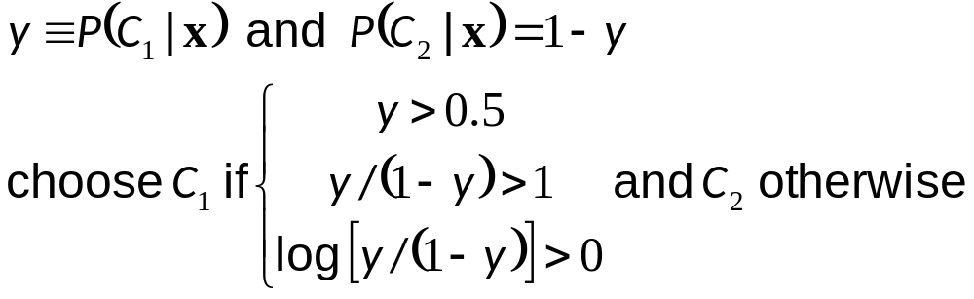
From Discriminants to Posteriors
When p (x | C_{i} ) ~ N ( μ_{i} , ∑)

Slide 10
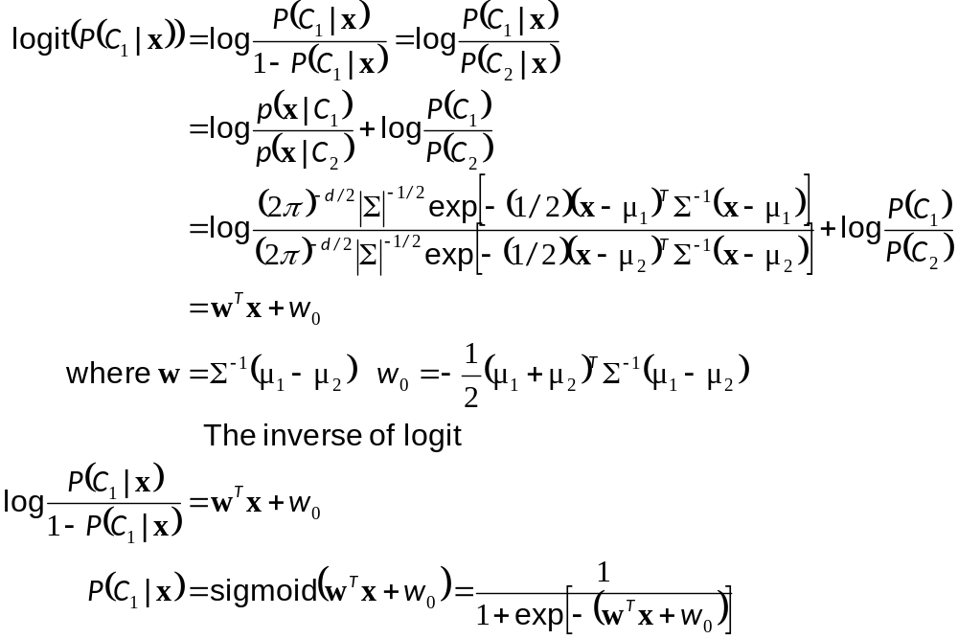

Slide 11
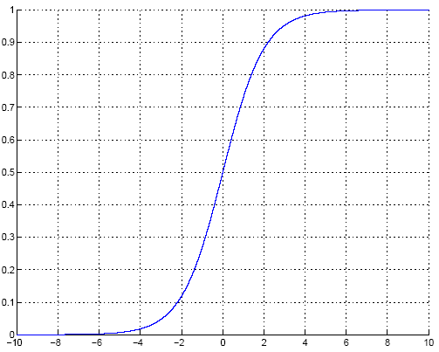
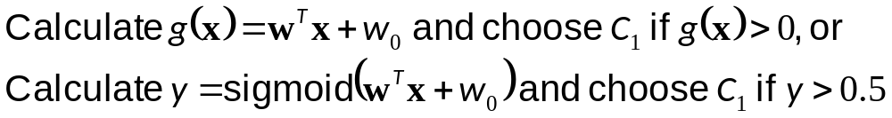
Sigmoid (Logistic) Function

Slide 12
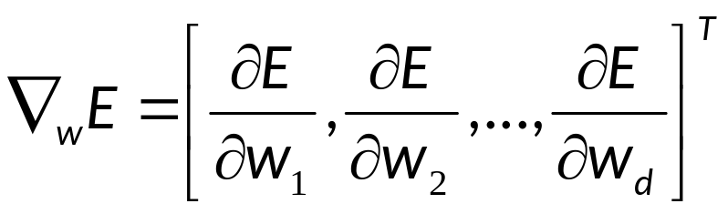
Gradient-Descent
E(w|X) is error with parameters w on sample X
w*=arg min_{w} E(w | X)
Gradient
Gradient-descent:
  Starts from random w and updates w iteratively in the negative direction of gradient

Slide 13
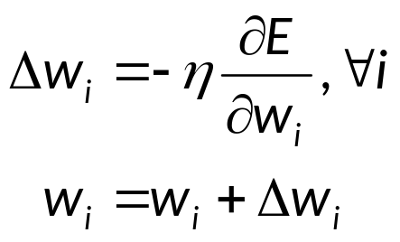
Gradient-Descent
E (w^{t})
E (w^{t+1})
w^{t}
w^{t+1}
η

Slide 14
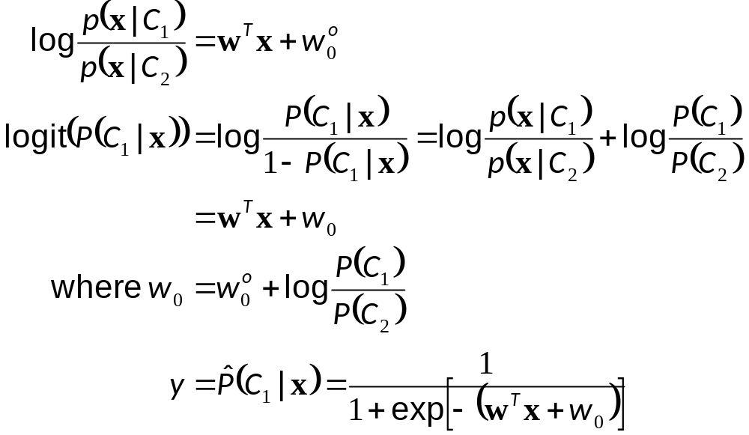
Logistic Regression(Discrimination)
Two classes: Assume log likelihood ratio is linear

Slide 15
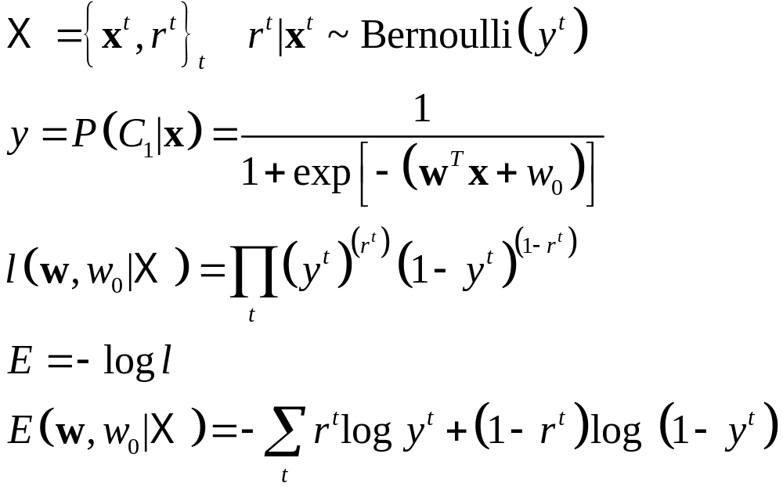
Training: Two Classes

Slide 16
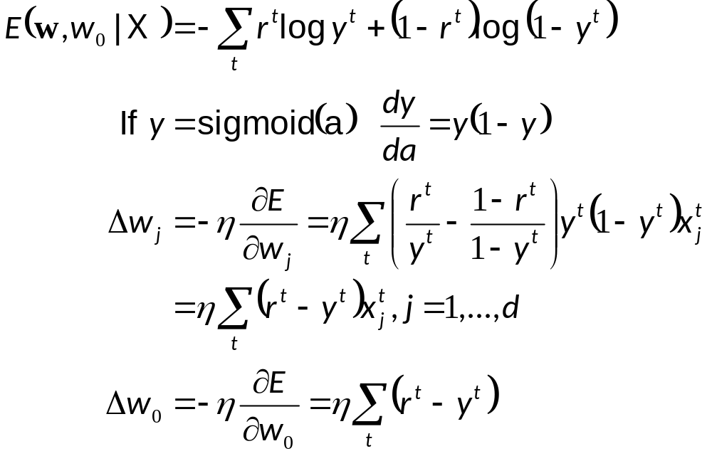
Training: Gradient-Descent

Slide 17
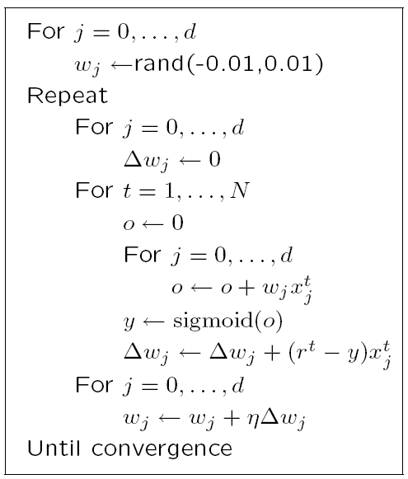

Slide 18
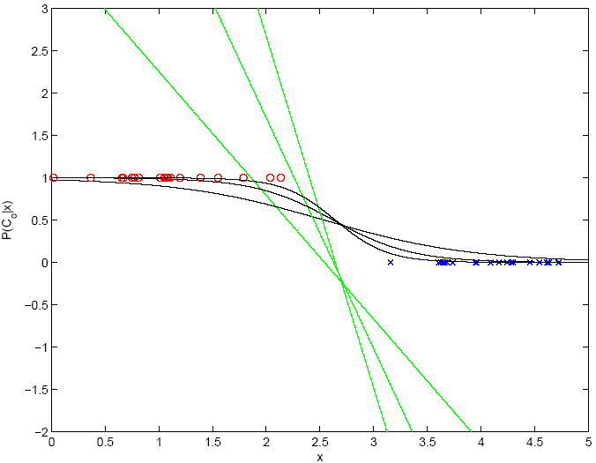
100
1000
10

Slide 19
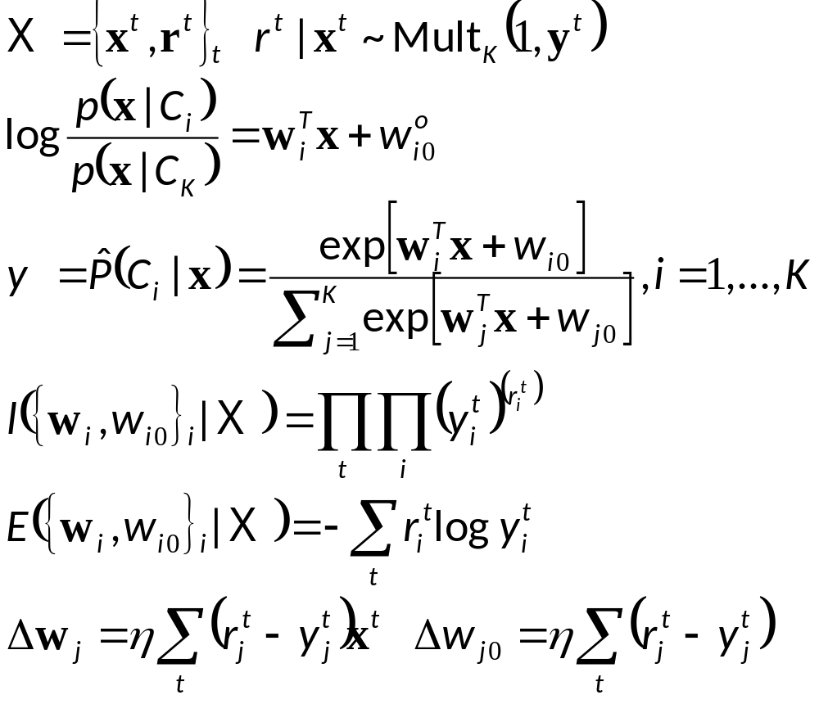
K>2 Classes
softmax

Slide 20
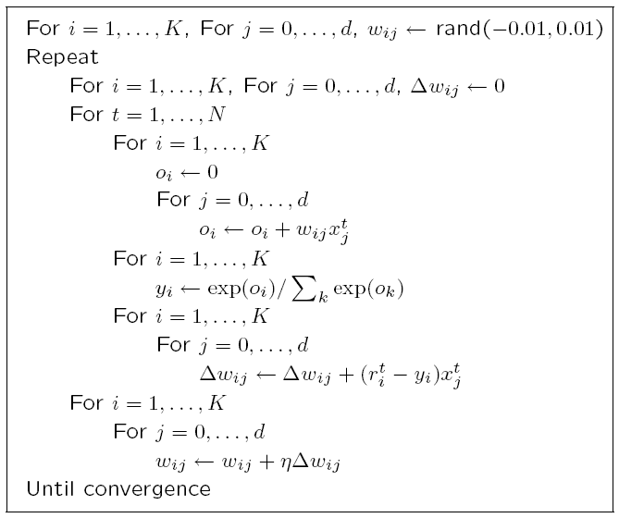

Slide 21
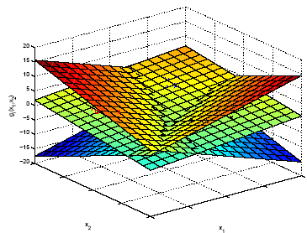
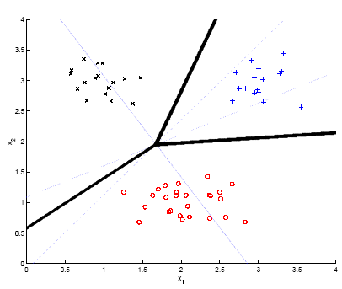
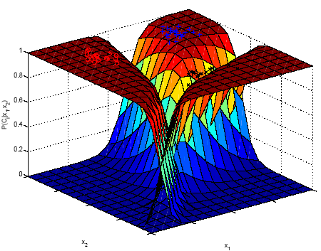
Example

Slide 22
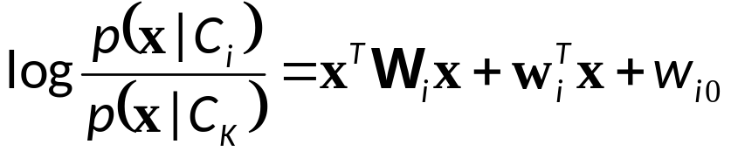
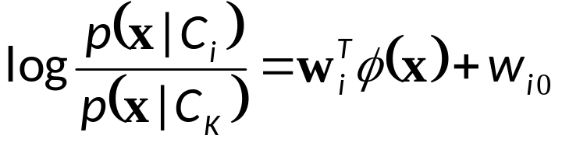
Generalizing the Linear Model
Quadratic:
Sum of basis functions:
where φ(x) are basis functions. Examples:
  Hidden units in neural networks (Chapters 11 and 12)
  Kernels in SVM (Chapter 13)

Slide 23
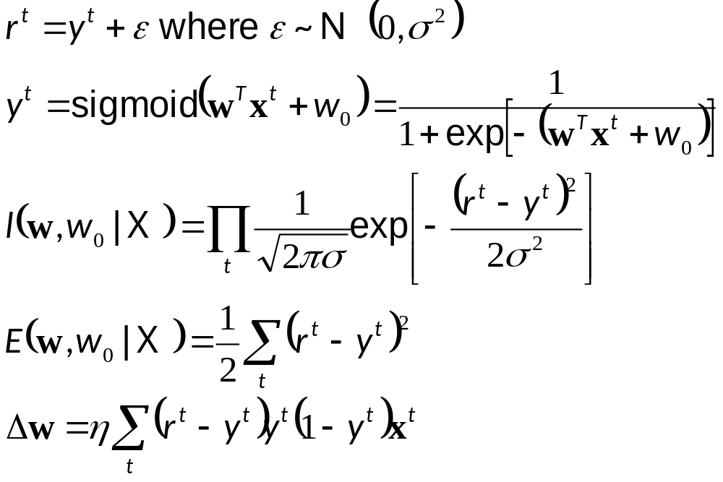
Discrimination by Regression
Classes are NOT mutually exclusive and exhaustive

Slide 24
Learning to Rank
Ranking: A different problem than classification or regression
Let us say x^{u} and x^{v} are two instances, e.g., two movies
We prefer u to v implies that g(x^{u})>g(x^{v})
where g(x) is a score function, here linear:
g(x)=w^{T}x
Find a direction w such that we get the desired ranks when instances are projected along w

Slide 25
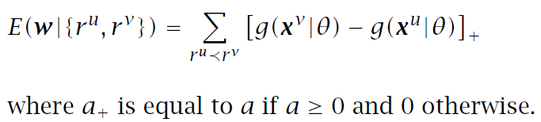
Ranking Error
We prefer u to v implies that g(x^{u})>g(x^{v}), so
error is g(x^{v})-g(x^{u}), if g(x^{u})<g(x^{v})

Slide 26
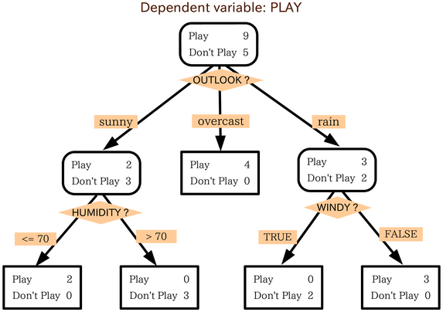
Decision Tree
What is Decision Tree?
Information Theory
How to build Decision Tree
Summary

Slide 27
Review of Classification
Given a set of attributes (X1,X2, …, Xn) of an object, predict its label/class (C) based on training examples
Three types of attributes:
  Numerical/continuous: Domain is ordered and can be represented on the real line (e.g., age, income)
    (0.3, 0.4, 0. 5, …)
  Ordinal: Domain is ordered, but absolute differences between values is unknown (e.g., preference scale, severity of an injury)
    Grade: (A, B, C, D)
  Nominal or categorical: Domain is a finite set without any natural ordering (e.g., occupation, marital status, race)
    Color: (red, blue, yellow)

Slide 28
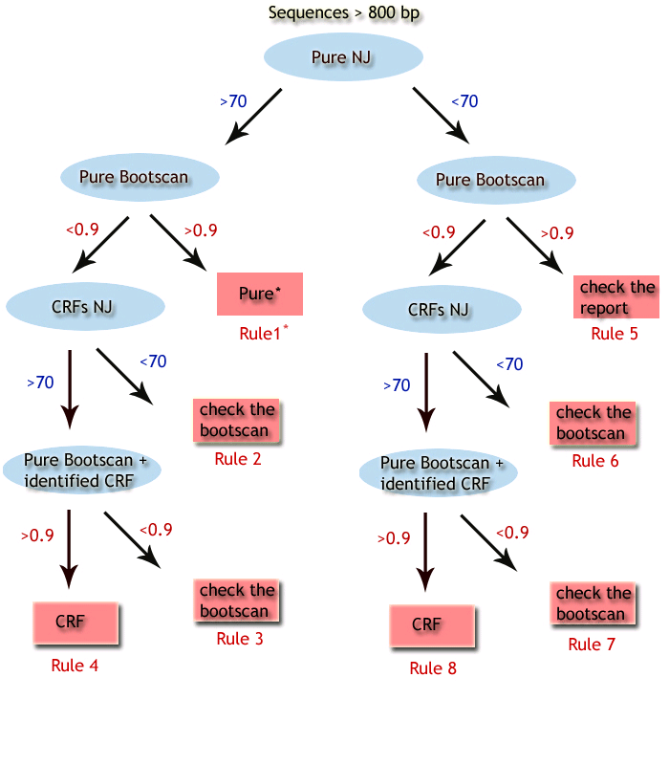
What is Decision Tree?
REGA HIV-1 Subtying Decision Tree Classifier

Slide 29
What is Decision Tree?
They do classification: predict a categorical output from categorical and/or real inputs
Decision trees are the single most popular data mining tool
  Easy to understand
  Easy to implement
  Easy to use
  Computationally cheap
Mature, Easy-to-use software package freely available (used for the assignment 2)
NO programming needed!

Slide 30
What is Decision Tree?
Extremely popular method
  Credit risk assessment
  Medical diagnosis
  Market analysis
  Bioinformatics
  Chemistry
  A literature search in pubmed.org retrieves 6906 papers related to decision trees!
Good at dealing with symbolic feature

Slide 31
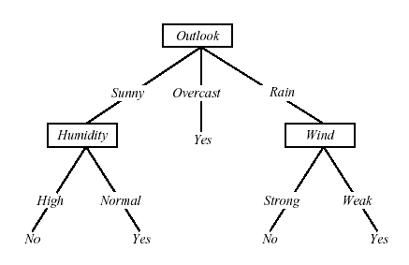
Decision Tree Representation
Classify instances by sorting them down the tree from the root to some leaf node
Each branch corresponds to attribute value
Each internal node has a splitting predicate
Each leaf node assigns a classification

Slide 32
Internal Nodes
Each internal node has an associated splitting predicate. Most common are binary predicates.
Example predicates:
  Age <= 20
  Profession in {student, teacher}
  5000*Age + 3*Salary – 10000 > 0

Slide 33
Internal Nodes: Splitting Predicates
Binary Univariate splits:
  Numerical or ordered X: X <= c, c in dom(X)
  Categorical X: X in A, A subset dom(X)
Binary Multivariate splits:
  Linear combination split on numerical variables:
  Σ a_{i}X_{i} <= c
k-ary (k>2) splits analogous

Slide 34
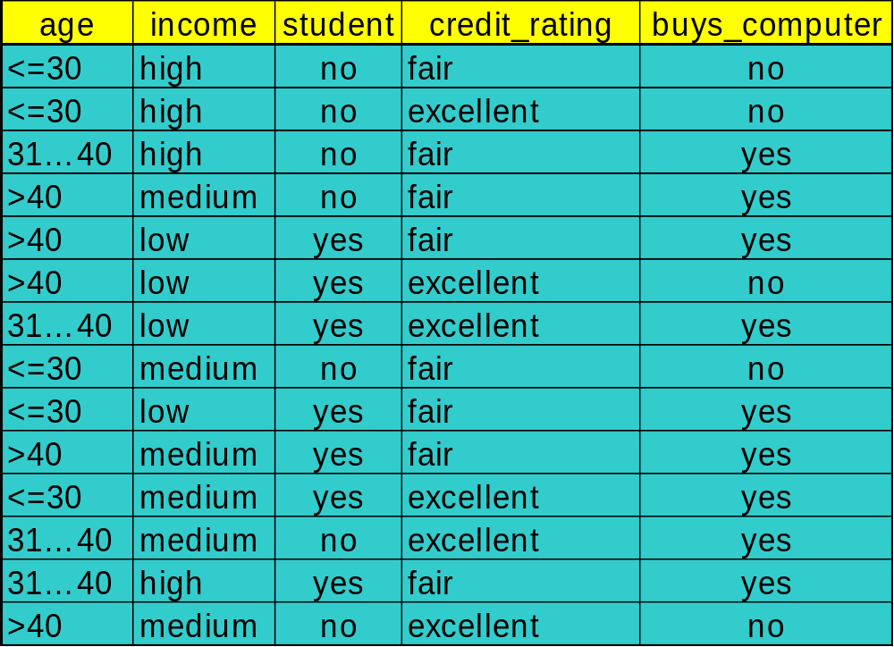
Building Decision Tree Classifiers for DELL to Predict if a customer would buy a computer
Training Data

Slide 35
Output: A Decision Tree for “buys_computer”
age?
<=30
overcast
>40
31..40
student?
yes
credit rating?
no
yes
excellent
fair
no
yes
no
yes
Homogeneous: All labels of the instances are YES
Majority Voting 4/5

Slide 36
TDIDT Algorithm
Also known as ID3 (Quinlan)
To construct decision tree T from learning set S:
  If all examples in S belong to some class C Then
  make leaf labeled C
  Otherwise
    select the “most informative” attribute A
    partition S according to A’s values
    recursively construct subtrees T1, T2, ..., for the subsets of S

Slide 37
Algorithm for Decision Tree Induction
Basic algorithm (a greedy algorithm)
  Tree is constructed in a top-down recursive divide-and-conquer manner
  At start, all the training examples are at the root
  Attributes are categorical (if continuous-valued, they are discretized in advance)
  Examples are partitioned recursively based on selected attributes
  Test attributes are selected on the basis of a heuristic or statistical measure (e.g., information gain)
Conditions for stopping partitioning
  All samples for a given node belong to the same class
  There are no remaining attributes for further partitioning – majority voting is employed for classifying the leaf
  There are no samples left

Slide 38
Design Issues of Decision Trees
age?
Which decision tree is the best?
Which attributes to check first? How to split?
How to decide the split values of real-value attributes (e.g. age)?
When to stop splitting?
How to evaluate decision trees?
<=30
overcast
31..40
>40
student?
yes
credit rating?
no
yes
excellent
fair
no
yes
no
yes

Slide 39
Which Decision Tree is the Best?
Occam’s razor: (year 1320)
  Prefer the simplest hypothesis that fits the data.
  The principle states that the explanation of any phenomenon should make as few assumptions as possible, eliminating those that make no difference in the observable predictions of the explanatory hypothesis or theory
Albert Einstein: Make everything as simple as possible, but not simpler.
Why?
  It’s a philosophical problem.
  Simple explanation/classifiers are more robust
  Simple classifiers are more understandable

Slide 40
How To Build a Simple Decision Tree?: Attribute Selection
Intuitively (as in the game):
  We want to reduce the search space (ambiguity) ASAP by asking each question
Scientifically:
  Test attributes that gain most information.
Remember: The splitting process of decision tree stops only when the labels of all instances in a node becomes pure (homogeneous) except other special cases.

Slide 41
How To Build a Simple Decision Tree
Objective: Shorter trees are preferred over larger Trees
Idea: want attributes that classifies examples well. The best attribute is selected.
  Select attribute which partitions the learning set into subsets as “pure” as possible
How well an attribute alone classifies the training data?

Slide 42
Information Theory
Claude E. Shannon's classic paper "A Mathematical Theory of Communication" in the Bell System Technical Journal in July and October of 1948.
Key Concepts:
  Entropy, H, of a discrete random variable X is a measure of the amount of uncertainty associated with the value of X.
  Information (Gain): reduction of entropy (uncertainty)
  Mutual Information: measures the amount of information that can be obtained about one random variable by observing another. (can be used for feature selection)

Slide 43

Measuring Entropy
  Entropy, H, of a discrete random variable X is a measure of the amount of uncertainty associated with the value of X.
    In our case: the random variable is the class label of an instance (C)
    For two training data with 10 instances at the root node
    Data 1: 9 positive, 1 negative
    Data 2: 5 positive, 5 negative
  For objects of Data 1 and 2, whose label is more uncertain?

Slide 44

Measuring Mutual Information
measures the amount of information that can be obtained about one random variable by observing another.
  Exercise: calculate the mutual information between the class label and an attribute
Mutual information in feature selection:
  Input Feature Selection by Mutual Information Based on Parzen Windows
  Mutual information functions versus correlation functions. Journal of Statistical Physics, 2005

Slide 45

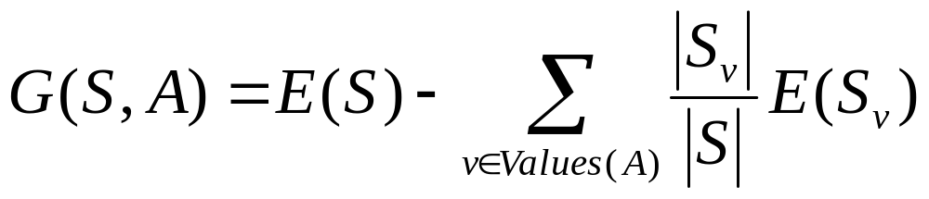
Information Gain ( used in ID3)
What is the uncertainty removed by splitting on the value of A?
The information gain of S relative to attribute A is the expected reduction in entropy caused by knowing the value of A
  : the set of examples in S where attribute A has value v

Slide 46
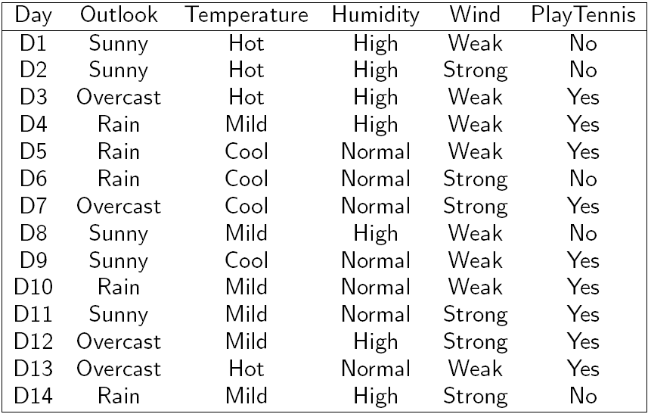
Play Tennis Example

Slide 47
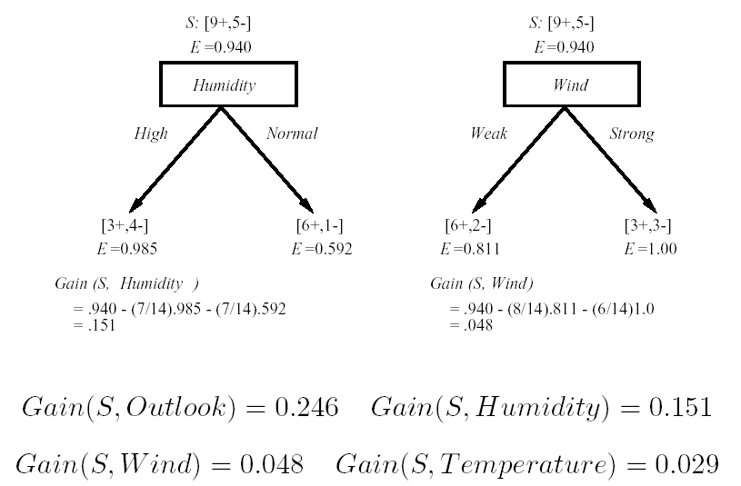
Which attribute is the best classifier?

Slide 48
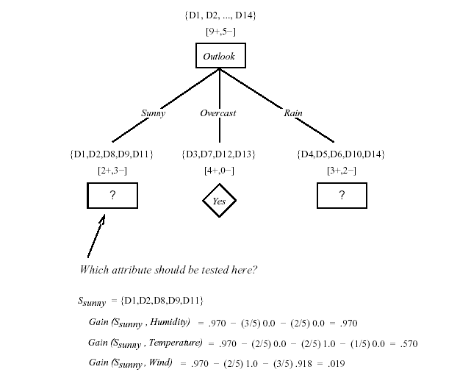

Slide 49
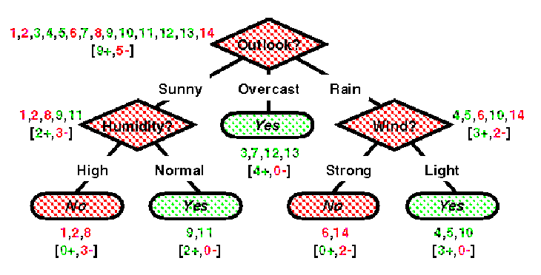
A1 = overcast: + (4.0)
A1 = sunny:
| A3 = high: - (3.0)
| A3 = normal: + (2.0)
A1 = rain:
| A4 = weak: + (3.0)
| A4 = strong: - (2.0)
See/C 5.0

Slide 50
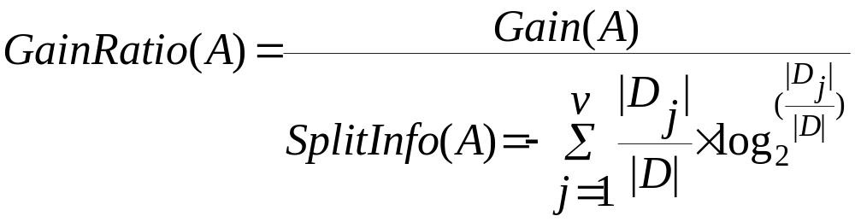
Gain Ratio (used in C4.5)
Limitation of Information Gain
  Biased towards attributes with many outcomes: not robust
  Example: suppose an attribute A has 14 distinct values (product_id), splitting on A, will result maximum information gain. H(Di)=0.
Gain Ratio: normalization applied to information gain
  Normalized by the split information (penalize multiple-valued attributes/splits)
  J.R. Quinlan (1986). Induction of Decision Trees, Machine Learning, (1), 81-106

Slide 51

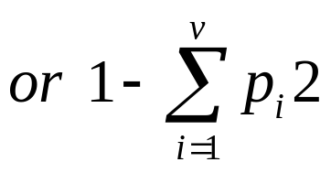

Gini Index (CART, IBM IntelligentMiner)
Another sensible measure of impurity
(i and j are classes)
a function the maximize when x=y? f=xy given x+y=1
After applying attribute A, the resulting Gini index is
Gini can be interpreted as expected error rate

Slide 52
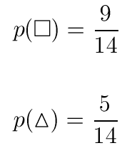


Gini Index
.
.
.
.
.
.

Slide 53





Gini Index for Color
.
.
.
.
.
.
.
.
red
Color?
green
.
yellow
.
.
.

Slide 54
Gain of Gini Index

Slide 55
Comparing Attribute Selection Measures
The three measures, in general, return good results but
  Information gain:
    biased towards multivalued attributes
  Gain ratio:
    tends to prefer unbalanced splits in which one partition is much smaller than the others
  Gini index:
    biased to multivalued attributes
    has difficulty when # of classes is large
    tends to favor tests that result in equal-sized partitions and purity in both partitions

Slide 56
Computing Information-Gain for Continuous-Value Attributes
Let attribute A be a continuous-valued attribute
Must determine the best split point for A
  Sort the value A in increasing order
  Typically, the midpoint between each pair of adjacent values is considered as a possible split point
    (a_{i}+a_{i+1})/2 is the midpoint between the values of a_{i} and a_{i+1}
  The point with the minimum expected information requirement for A is selected as the split-point for A
Split:
  D1 is the set of tuples in D satisfying A ≤ split-point, and D2 is the set of tuples in D satisfying A > split-point

Slide 57
Other Attribute Selection Measures
CHAID: a popular decision tree algorithm, measure based on χ² test for independence
C-SEP: performs better than info. gain and gini index in certain cases
G-statistics: has a close approximation to χ² distribution
MDL (Minimal Description Length) principle (i.e., the simplest solution is preferred):
  The best tree as the one that requires the fewest # of bits to both (1) encode the tree, and (2) encode the exceptions to the tree
Multivariate splits (partition based on multiple variable combinations)
  CART: finds multivariate splits based on a linear comb. of attrs.
Which attribute selection measure is the best?
  Most give good results, none is significantly superior than others

Slide 58
Issues in Decision Tree
Overfiting
Tree Pruning
Cross-validation
Model Evaluation
Advanced Decision Tree
C4.5 Software Package

Slide 59

















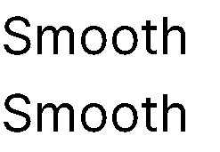

















Random Forests
Tree 1
Tree 2
Random Forest
Tree N

Slide 60
Random Forests Algorithm
For b = 1 to B:
  (a) Draw a bootstrap sample Z∗ of size N from the training data.
  (b) Grow a random-forest tree to the bootstrapped data, by recursively repeating the following steps for each terminal node of the tree, until the minimum node size n_{min} is reached.
    i. Select m variables at random from the p variables.
    ii. Pick the best variable/split-point among the m.
    iii. Split the node into two daughter nodes.
  Output the ensemble of trees.
To make a prediction at a new point x we do:
  For regression: average the results
  For classification: majority vote

Slide 61
Some unique designs
1. Out-of-Bag (OOB) Error Estimation
Concept: During training, not all data points are used for training a particular tree; some are left out of the bootstrap sample. These left-out data points are called out-of-bag samples.
Advantage: OOB samples can be used to estimate the model’s performance and provide a form of internal cross-validation, which saves computation time and provides an unbiased error estimate.
2. Feature Importance Measurement
Concept: Random Forest can evaluate the importance of each feature by measuring how much including a feature improves the model's performance, typically using metrics like mean decrease in impurity (Gini importance) or permutation importance.
Advantage: This helps in understanding which features are most influential for predictions and can guide feature selection and data analysis.
3. Handling Missing Values
Concept: Random Forest can handle missing values by using surrogate splits, where if the primary split feature has missing values, a secondary (surrogate) split is used to make the decision.
Advantage: This ability helps maintain predictive power even when dealing with incomplete datasets.

Slide 62
Random Forest
random forest is a classifier that consists of many decision trees and outputs the class that is the mode of the classes output by individual trees
  For many data sets, it produces a highly accurate classifier.
  It handles a very large number of input variables.
  It estimates the importance of variables in determining classification.
  It generates an internal unbiased estimate of the generalization error as the forest building progresses.
  It includes a good method for estimating missing data and maintains accuracy when a large proportion of the data are missing.
  It provides an experimental way to detect variable interactions.
  It can balance error in class population unbalanced data sets.
  It computes proximities between cases, useful for clustering, detecting outliers, and (by scaling) visualizing the data.
  Using the above, it can be extended to unlabeled data, leading to unsupervised clustering, outlier detection and data views.
  Learning is fast.

Slide 63
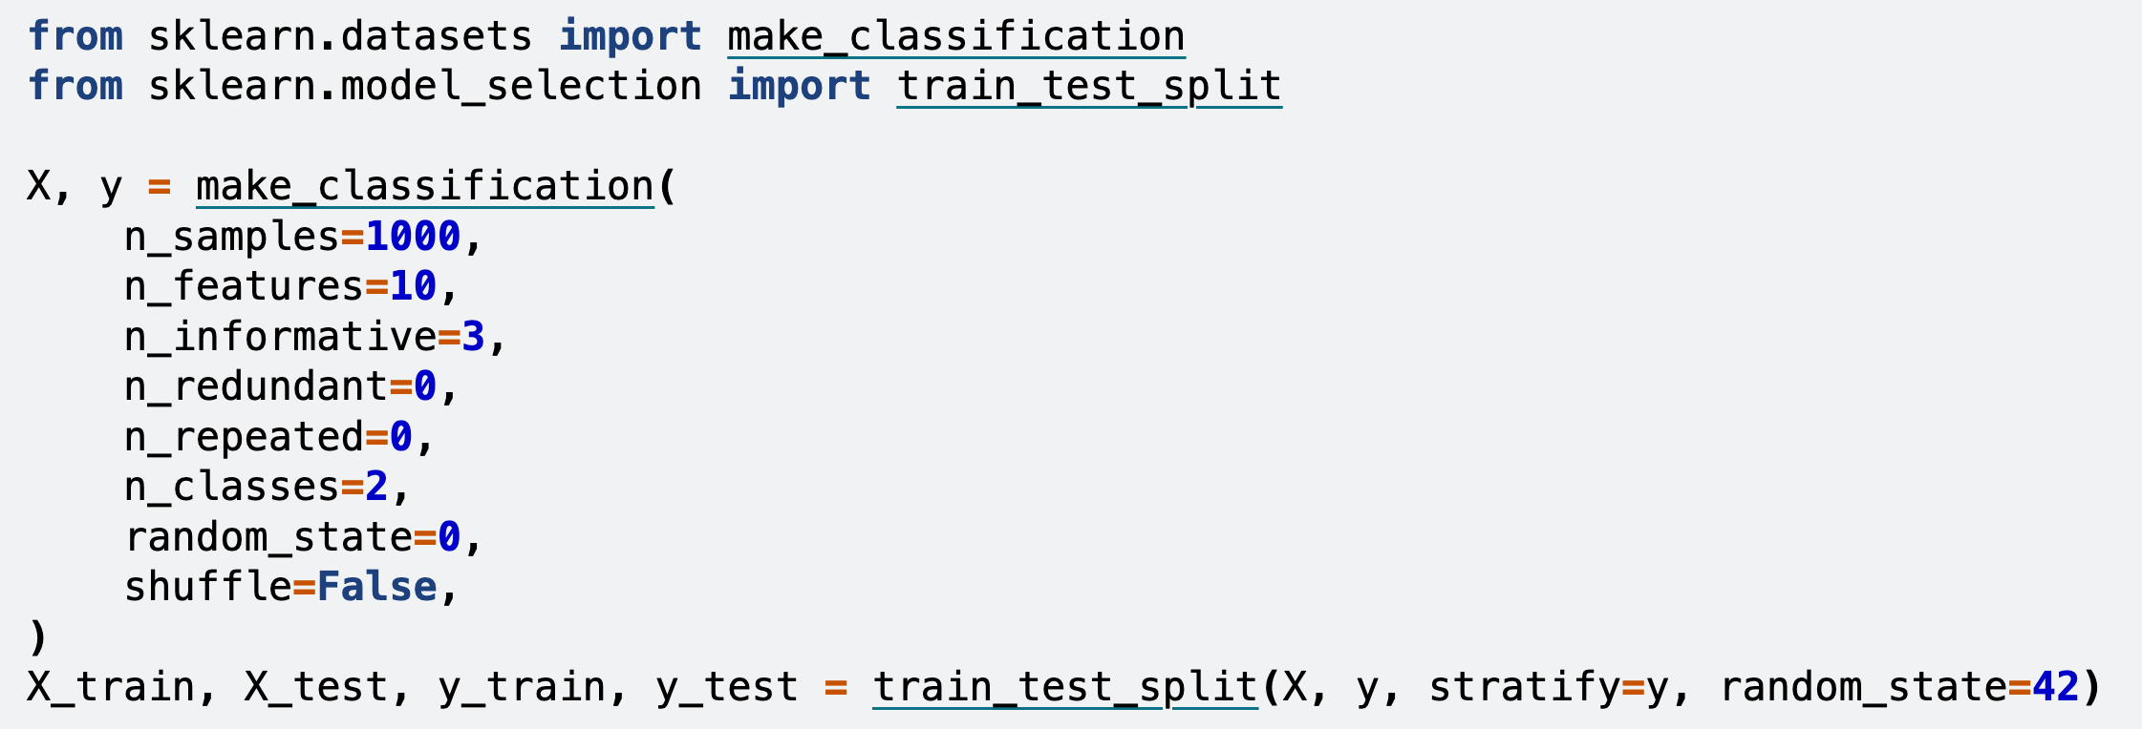
Scikit-learn code
from sklearn.ensemble import RandomForestClassifier
feature_names = [f"feature {i}" for i in range(X.shape[1])]
forest = RandomForestClassifier(random_state=0)
forest.fit(X_train, y_train)
import time
import numpy as np
start_time = time.time()
importances = forest.feature_importances_
std = np.std([tree.feature_importances_ for tree in forest.estimators_], axis=0)

Slide 64
Summary: Advantages of Decision Trees and RF
Simple to understand and interpret. People are able to understand decision tree models after a brief explanation.
Have value even with little hard data. Important insights can be generated based on experts describing a situation (its alternatives, probabilities, and costs) and their preferences for outcomes.
Use a white box model. If a given result is provided by a model, the explanation for the result is easily replicated by simple math.
Can be combined with other decision techniques.

Slide 65
Acknowledgements
http://www.cmpe.boun.edu.tr/~ethem/i2ml3e
https://users.cs.fiu.edu/~taoli/class/CAP4770-F10/class08.ppt

